Slide 1

Data project

Slide 2

AGENDA
Client inquiry
Exploratory Data analysis
Model training and assessment
Feature / outcome analysis
Results & conclusion

Slide 3

Client Question
In which countries would a company relocating with a family face the lowest health risks?

Slide 4

Kaggle World Health Statistics 2020
Supporting the client question

Slide 5
Initial dataset exploration
Life Expectancy at Birth | Maternal Mortality Ratio | Neonatal Mortality Rate | Infant Mortality Rate | Healthy life expectancy (HALE) at birth | Mortality Rate Poisoning
Under 5 Mortality Rate | Malaria Incidences | Tuberculosis Incidences | HIV Infection Rate | Hepatitis B Surface Antigen | Eliminate Violence Against Women
Suicide Rate | Poison Mortality Rate | Estimated Road Traffic Death Rate | Medical Doctors per 10K | intervention Against NTD's | at Least Basic Sanitization Services
Dentists per 10K | Pharmacists per 10K | Nursing / Midwife Personnel | Births Attended by Skilled Personnel | 30-70 cancer ChdEtc | Safely Sanitization
Population using at least basic drinking-water services | Total Sanitation Services | Basic Handwashing services | Tobacco Age 15 | Crude Suicide Rate | clean Fuel And Tech
Alcohol Substance Abuse | Reproductive Age Women | Road Traffic Deaths | Adolescent Birthrate | UHC Coverage
Data Availability UHC | Population10% SDG3 | population25%SDG3 | air Pollution Death Rate | mortality Rate Unsafe Wash
This dataset consisted of data regarding:
200 Countries
39 Features
1962 – 2019 Time Frame
12,609 Rows

Slide 6
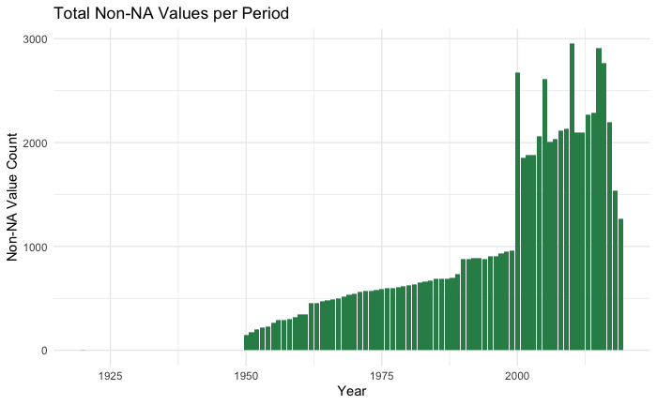
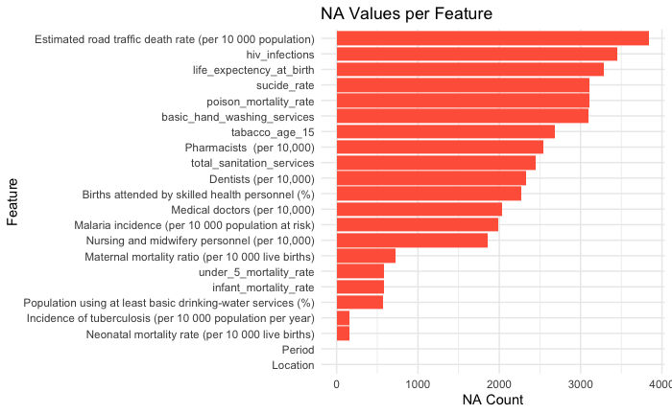
dataset Cleaning
This dataset consisted of data that were irrelevant to our approach with too many null values, therefore a quick scan of the following occurred:
What timeframe did the null values exist
What features had the highest number of null values

Slide 7
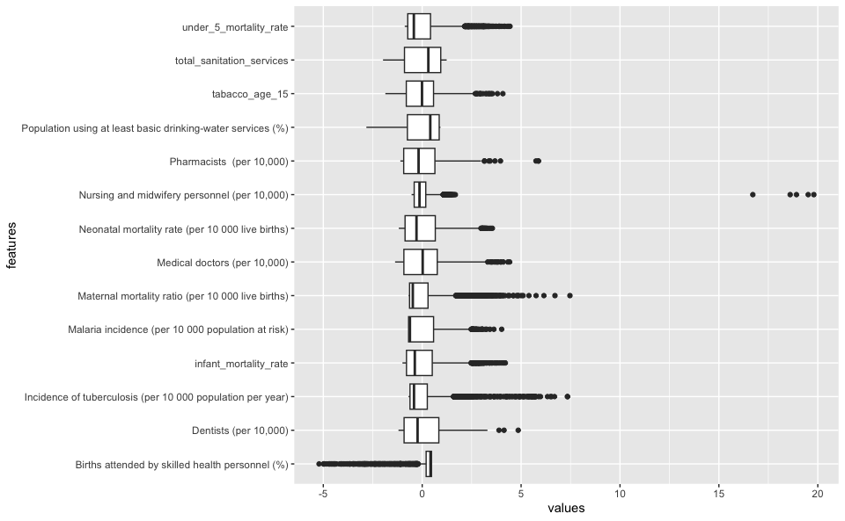
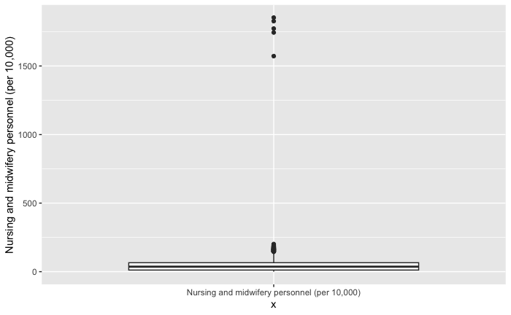
dataset Anomaly Detection

Slide 8
Initial dataset exploration
Life Expectancy at Birth | Maternal Mortality Ratio | Neonatal Mortality Rate | Infant Mortality Rate | Healthy life expectancy (HALE) at birth | Mortality Rate Poisoning
Under 5 Mortality Rate | Malaria Incidences | Tuberculosis Incidences | HIV Infection Rate | Hepatitis B Surface Antigen | Eliminate Violence Against Women
Suicide Rate | Poison Mortality Rate | Estimated Road Traffic Death Rate | Medical Doctors per 10K | intervention Against NTD's | at Least Basic Sanitization Services
Dentists per 10K | Pharmacists per 10K | Nursing / Midwife Personnel | Births Attended by Skilled Personnel | 30-70 cancer ChdEtc | Safely Sanitization
Population using at least basic drinking-water services | Total Sanitation Services | Basic Handwashing services | Tobacco Age 15 | Crude Suicide Rate | clean Fuel And Tech
Alcohol Substance Abuse | Reproductive Age Women | Road Traffic Deaths | Adolescent Birthrate | UHC Coverage
Data Availability UHC | Population10% SDG3 | population25%SDG3 | air Pollution Death Rate | mortality Rate Unsafe Wash
This dataset consisted of data regarding:
200 Countries
39 Features
1962 – 2019 Time Frame
12,609 Rows

Slide 9
Secondary dataset exploration
Life Expectancy at Birth | Maternal Mortality Ratio | Neonatal Mortality Rate | Infant Mortality Rate
Under 5 Mortality Rate | Malaria Incidences | Tuberculosis Incidences | HIV Infection Rate
Suicide Rate | Poison Mortality Rate | Estimated Road Traffic Death Rate | Medical Doctors per 10K
Dentists per 10K | Pharmacists per 10K | Nursing / Midwife Personnel | Births Attended by Skilled Personnel
Population using at least basic drinking-water services | Total Sanitation Services | Basic Handwashing services | Tobacco Age 15
Clean Fuel and Tech | Least Basic Sanitation Service
This dataset consisted of data regarding:
200 Countries
20 Features
2000 – 2019 Time Frame
4,020 Rows

Slide 10
Final dataset exploration
Population using at least basic drinking-water services | Maternal Mortality Ratio | Neonatal Mortality Rate | Infant Mortality Rate
Under 5 Mortality Rate | Malaria Incidences | Tuberculosis Incidences | Tobacco Age 15
Suicide Rate | Births Attended by Skilled Personnel | Nursing / Midwife Personnel | Medical Doctors per 10K
Dentists per 10K | Pharmacists per 10K
This dataset consisted of data regarding:
200 Countries
14 Features
2000 – 2019 Time Frame
4,020 Rows

Slide 11
Exploratory Data Analysis
Understanding the data

Slide 12
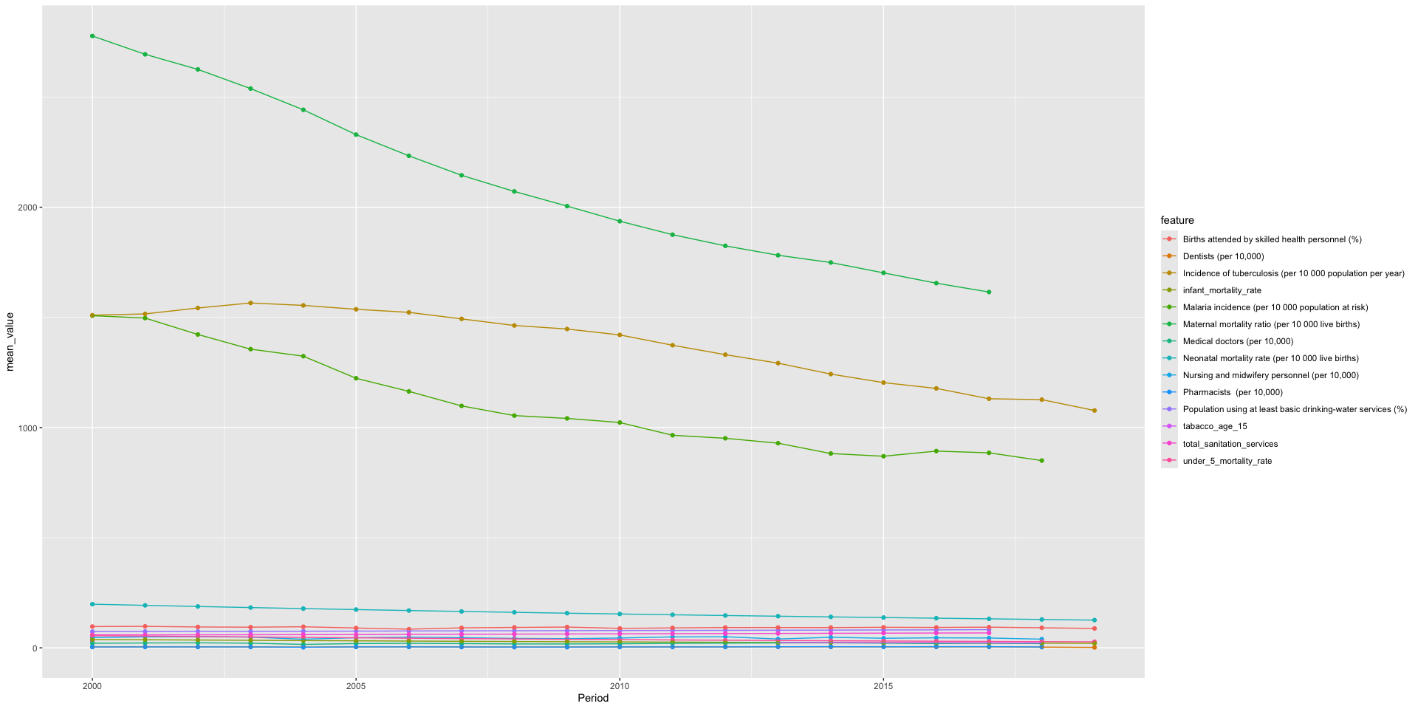
Exploratory Data analysis

Slide 13

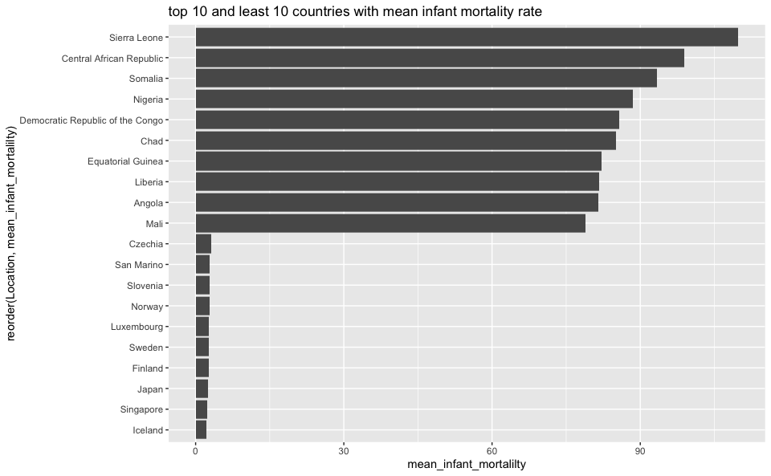
Exploratory data analysis

Slide 14
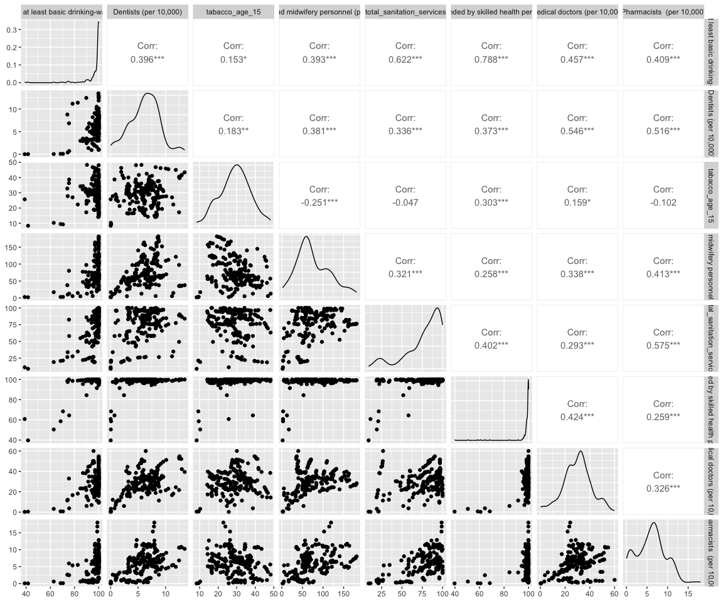
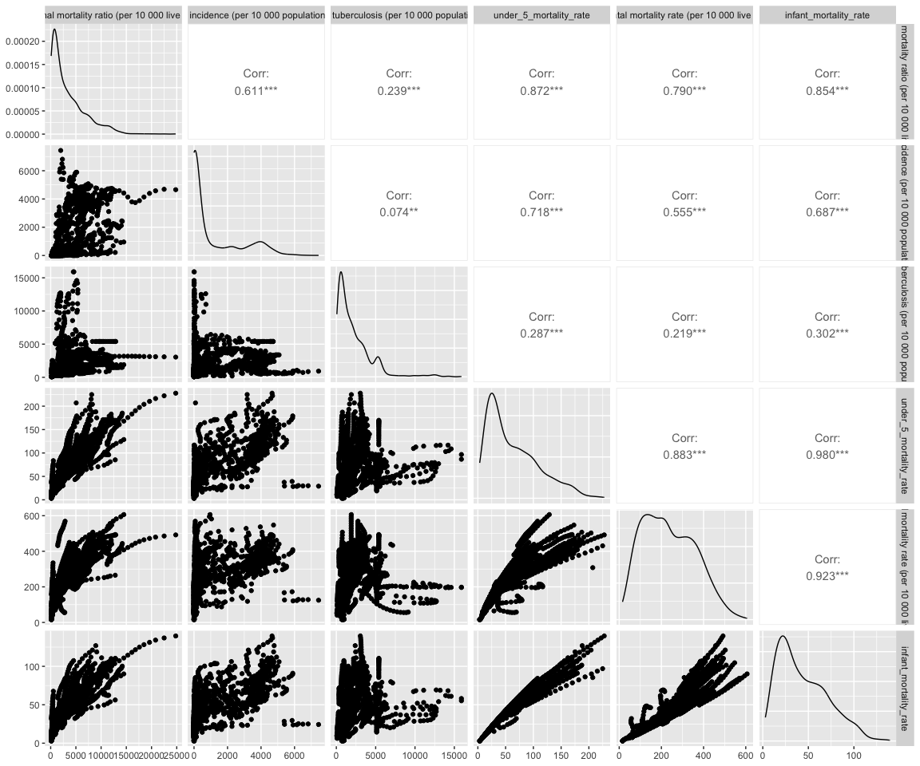
Feature Correlation Analysis

Slide 15
Regression and classification models
Attempting to answer the question

Slide 16
Infant Mortality Rate Regression Models
Model Name | Engine | Tuned
Linear Regression | LM | No
KNN | KKNN | Yes
Random Forest | Ranger | No
Lasso | GLMNet | Yes
XGBoost | XGBoost | No

Slide 17
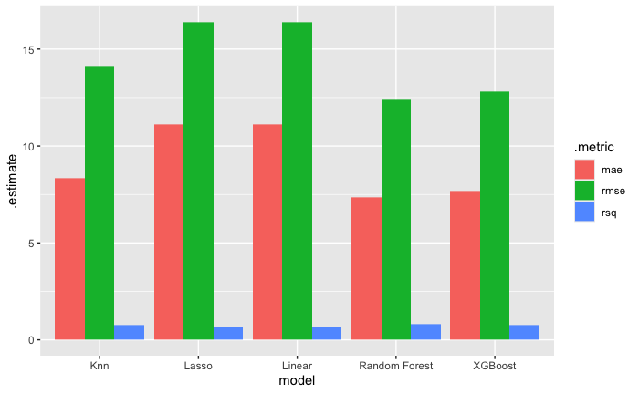
Regression models Metrics

Slide 18
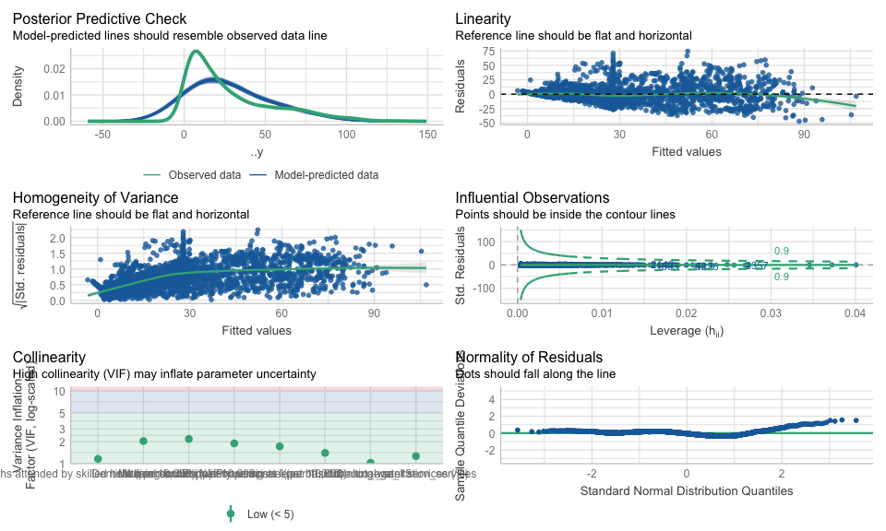
Linear Regression model Check

Slide 19
Tuberculosis Classification Models
Model Name | Engine | Tuned
KNN | KKNN | Yes
Random Forest | Ranger | No
Lasso | GLMNet | Yes
XGBoost | XGBoost | No

Slide 20
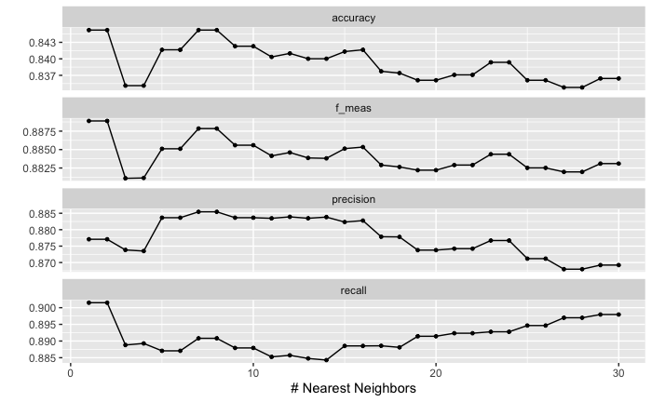
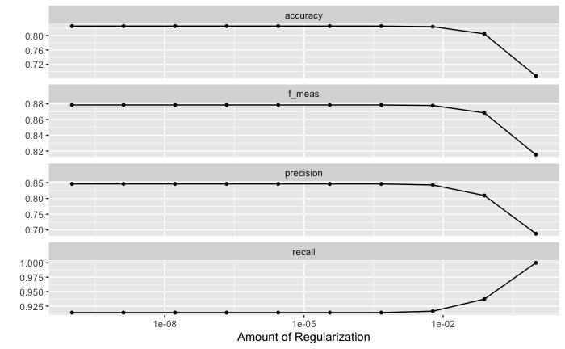
Classification models Parameter Tuning

Slide 21
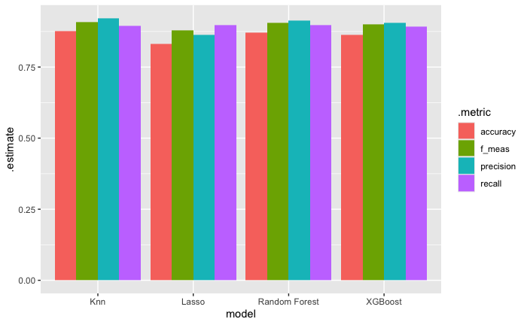
Classification models Metrics

Slide 22
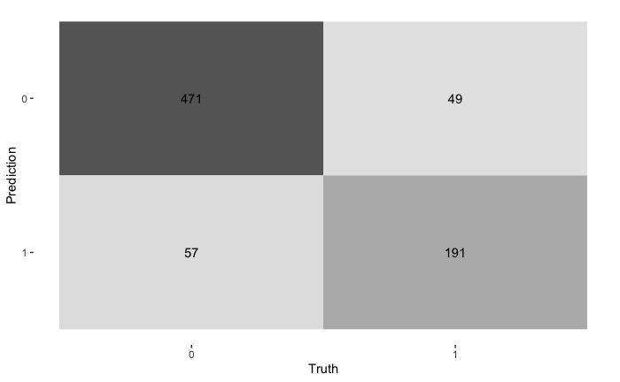
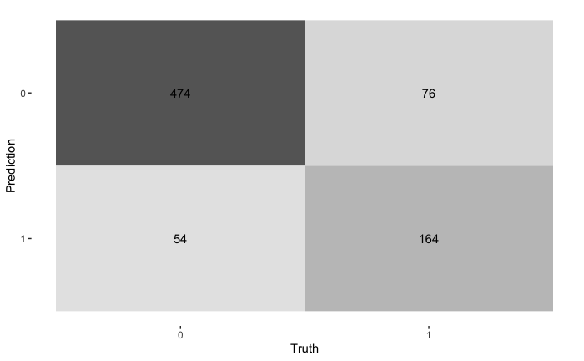


Classification models Confusion Matrices

Slide 23
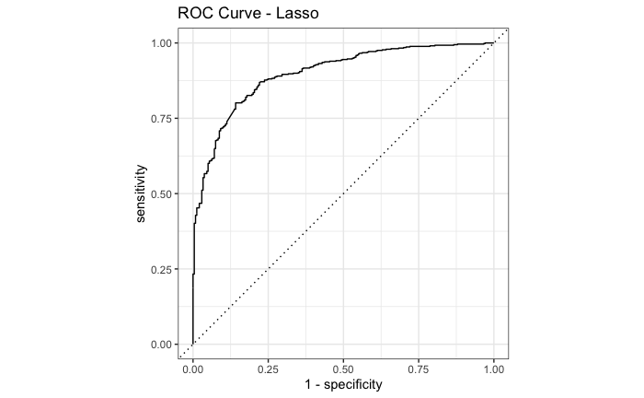
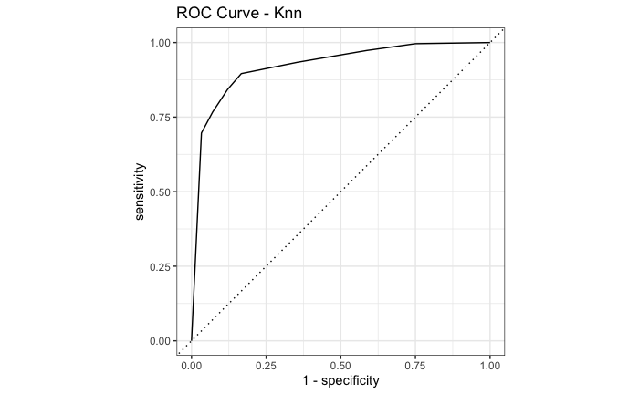
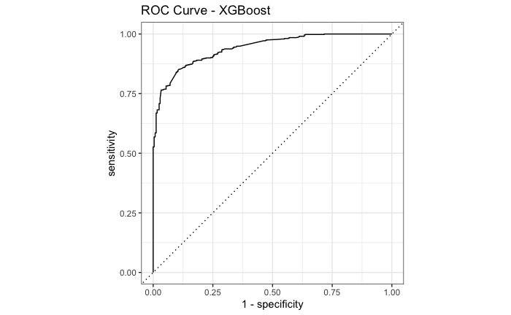
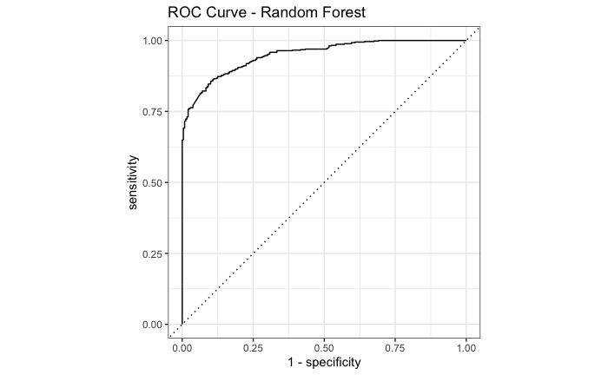
Classification models ROC Curves

Slide 24
Answering the burning Question
Back to the client

Slide 25
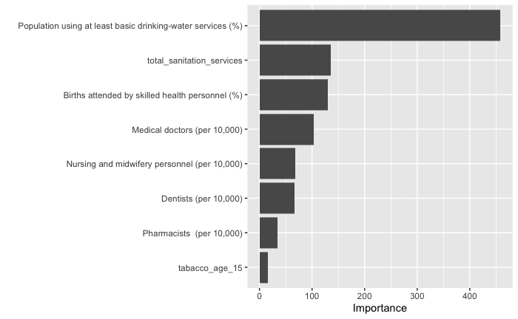
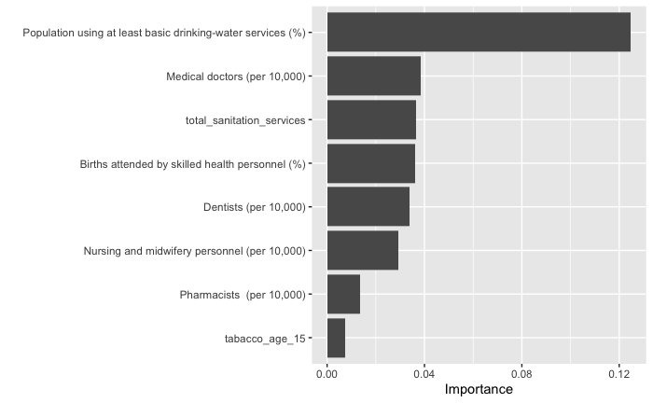
Feature Importance

Slide 26
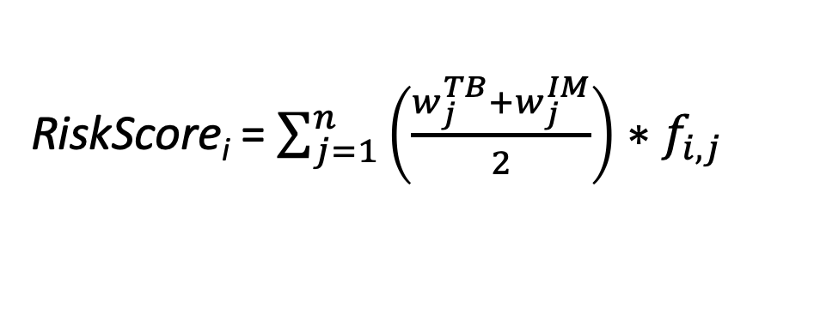
Equation for our Conclusion
RiskScore_{i} = $\sum_{j=1}^{n}{\left(\frac{w_{j}^{TB}+w_{j}^{IM}}{2}\right)∗f_{i,j}}$

Slide 27
Equation for our Conclusion
scaled mean of the feature importance between tuberculosis and infant mortality multiplied by the scaled sample values

Slide 28
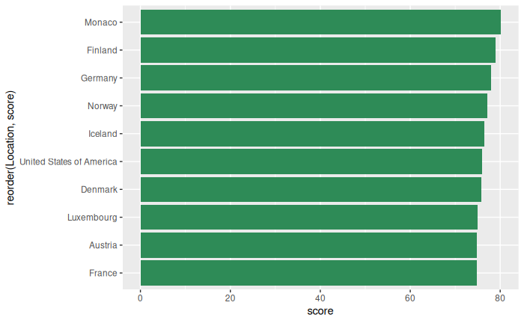
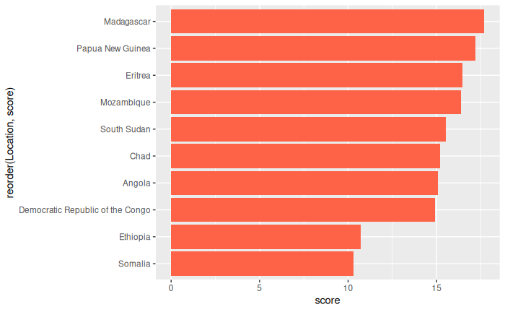
Conclusion

Slide 29

Resolving the problem
After our thorough analysis of the dataset, the most optimal countries for families to relocate to are
Monaco, Finland, Germany
While the Worst Countries are:
DRC, Ethiopia, Somalia

Slide 30

THANK YOU
William Ambrosetti
Alexandra Biddiscombe
Youssef Sedra

